Slide 1


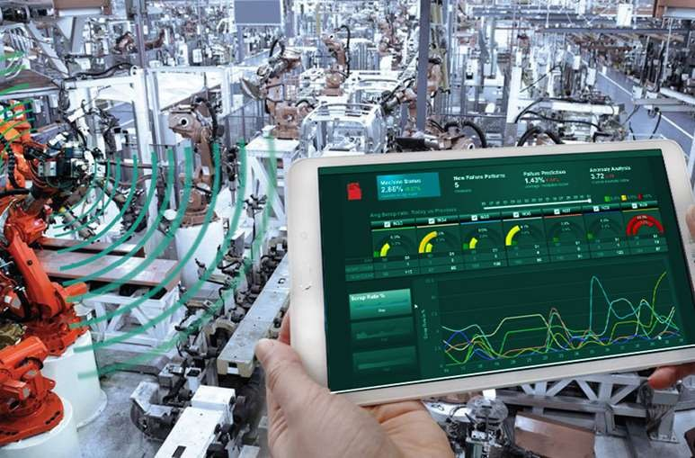


Slide 2

MACHINE LEARNING AND EDGE AI
Edge Impulse(Object Classification)

Slide 3
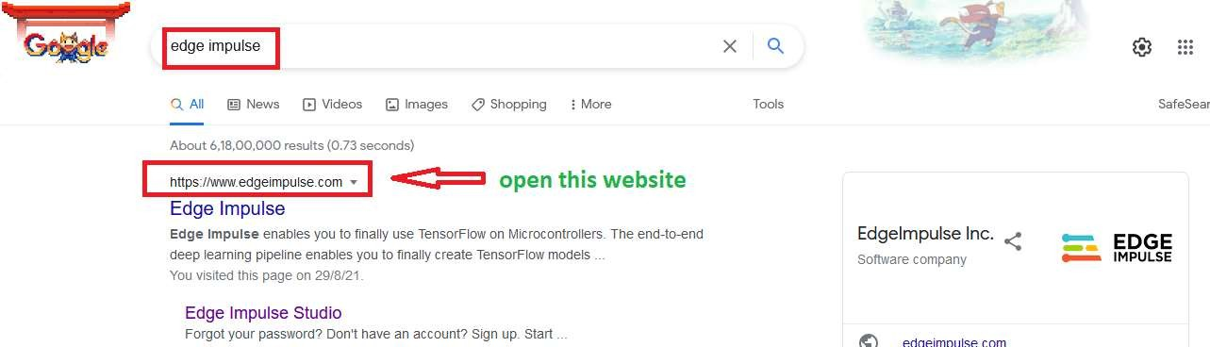
Open edge impulse website
www.edgeimpulse.com

Slide 4
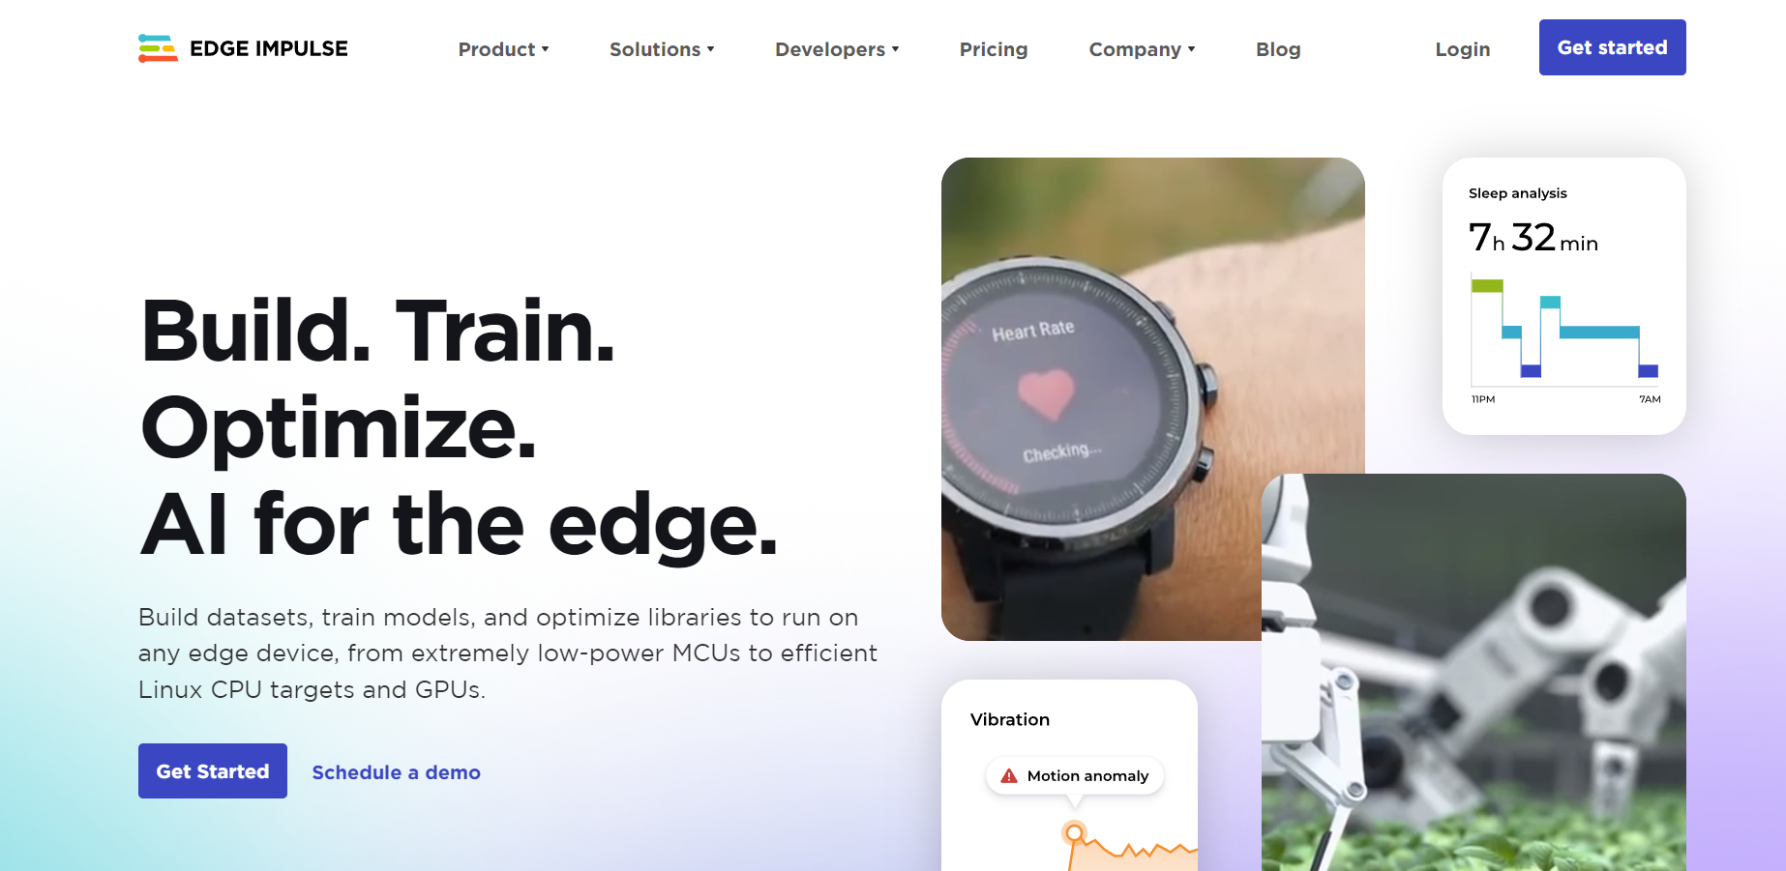
Sign up here

Slide 5
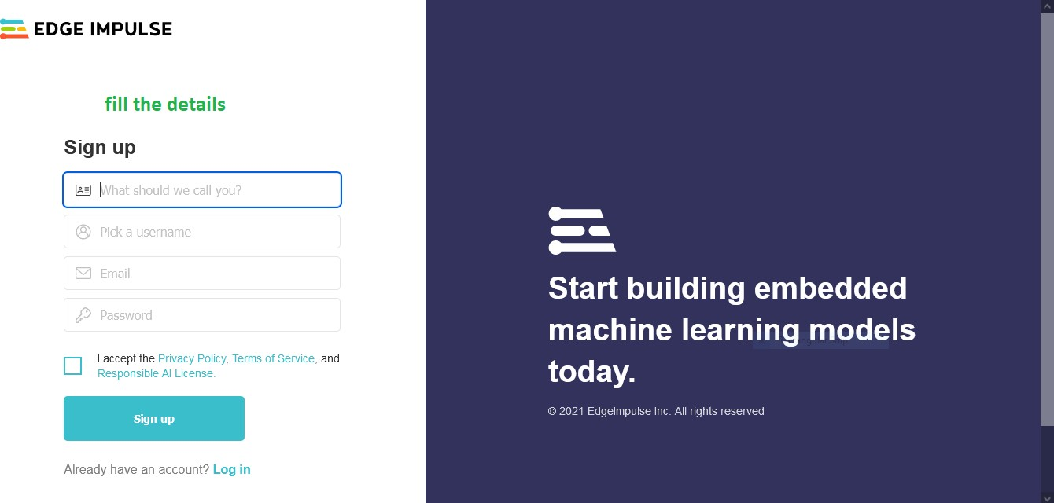
Fill the details

Slide 6
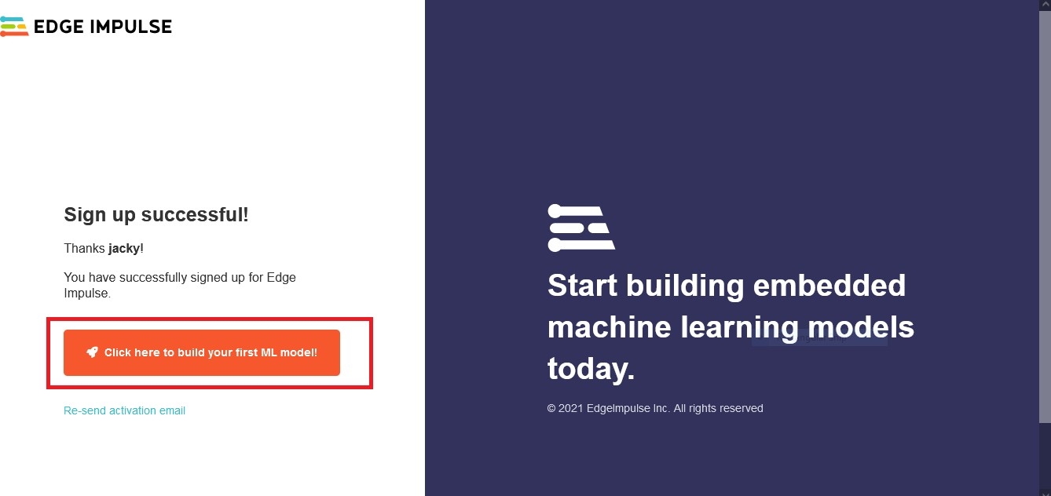
After sign-up successfully, click to build your ML model

Slide 7
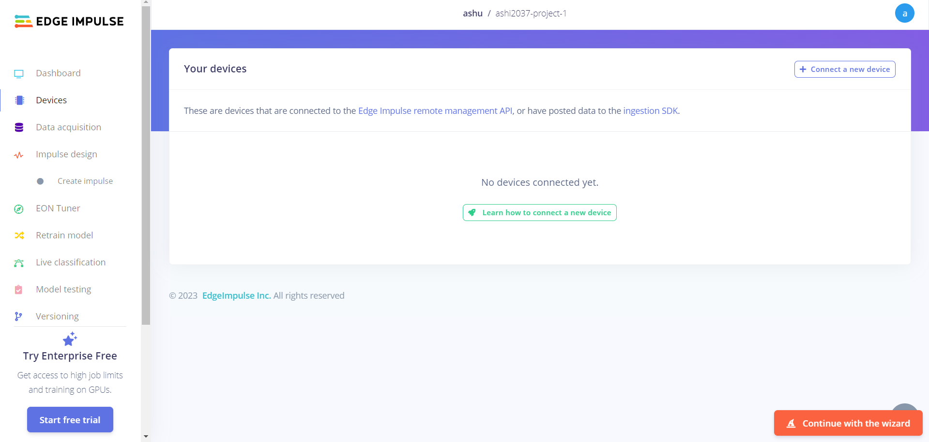

Slide 8
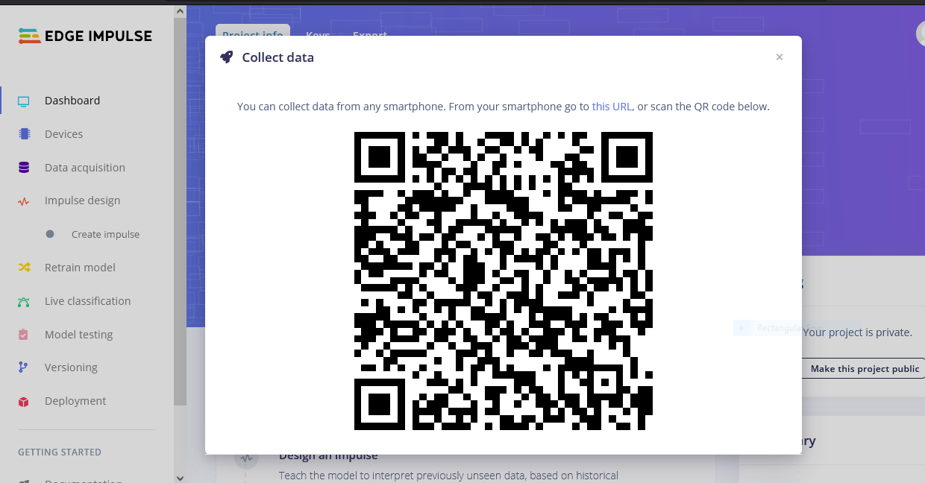
Scan QR Code With Mobile

Slide 9
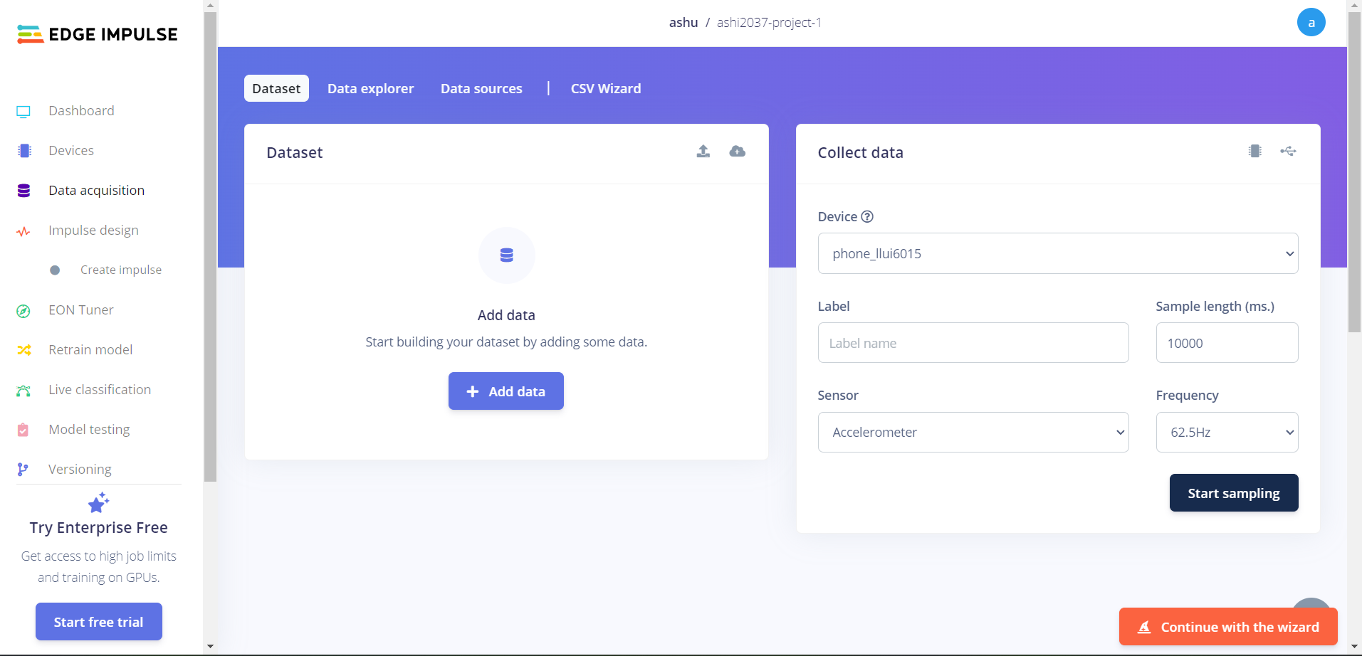
Now We Acquire Data

Slide 10
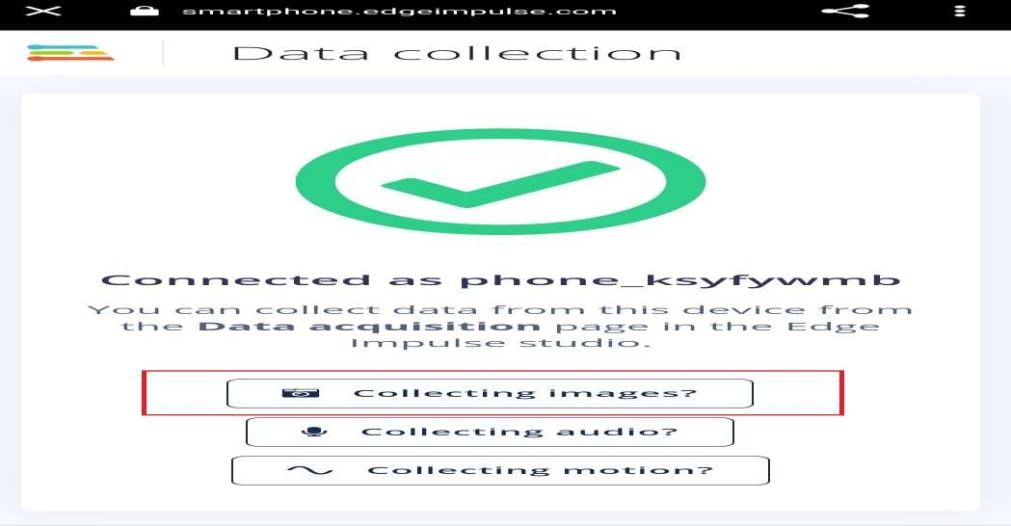
Click On Collecting Images In Your Mobile

Slide 11
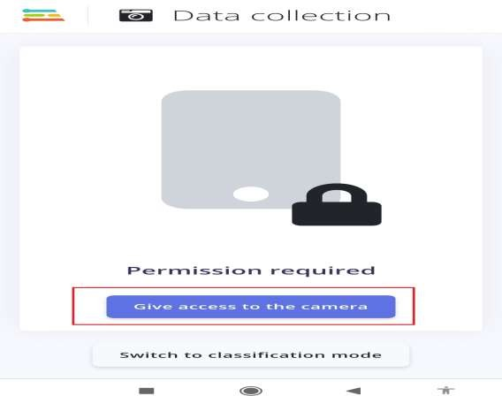
GIVE ACCESS TO THE CAMERA FOR CLICK IMAGES

Slide 12
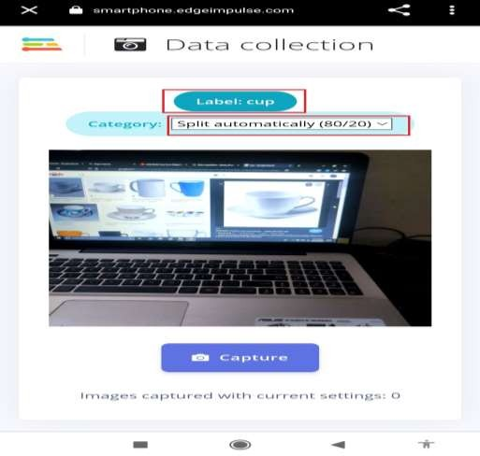
WRITE THE LABEL AND SELECT CATEGORY

Slide 13
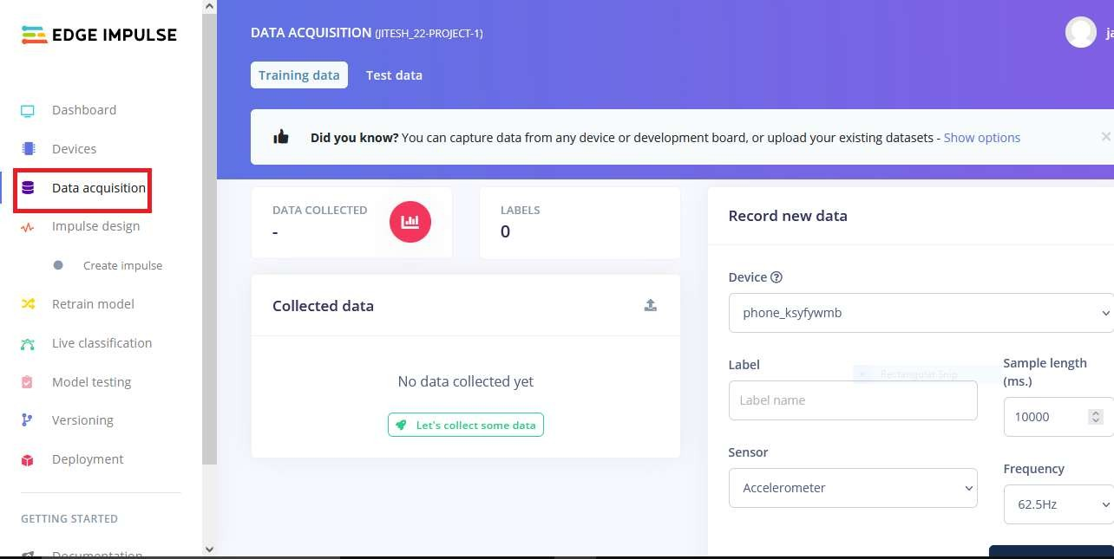
Click On Data Acquisition

Slide 14
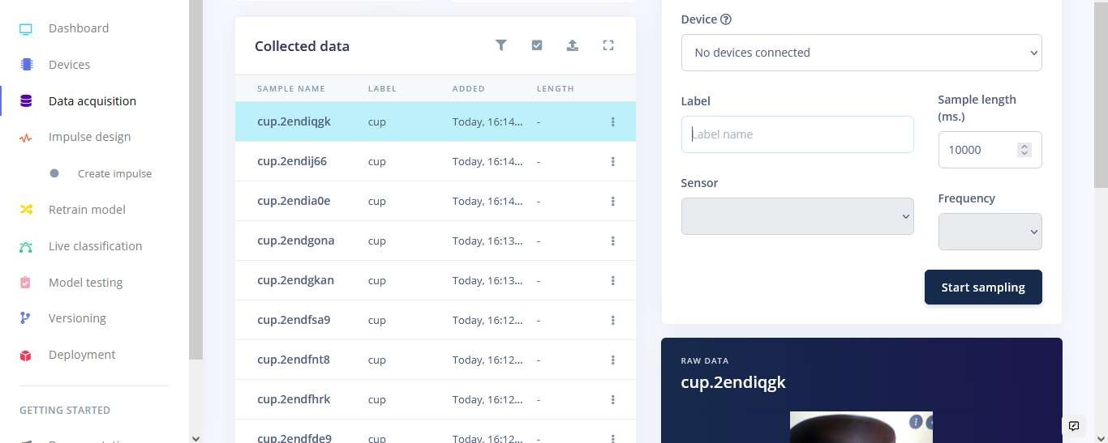
Now images are collecting

Slide 15
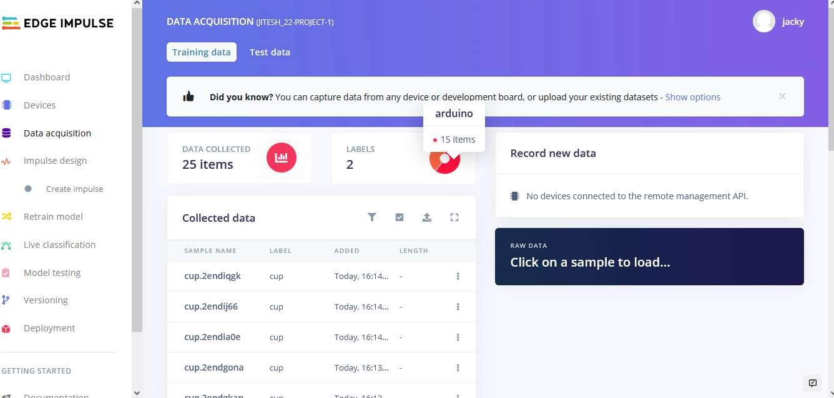
CHANGE THE LABEL IN MOBILE AND CLICK IMAGES

Slide 16
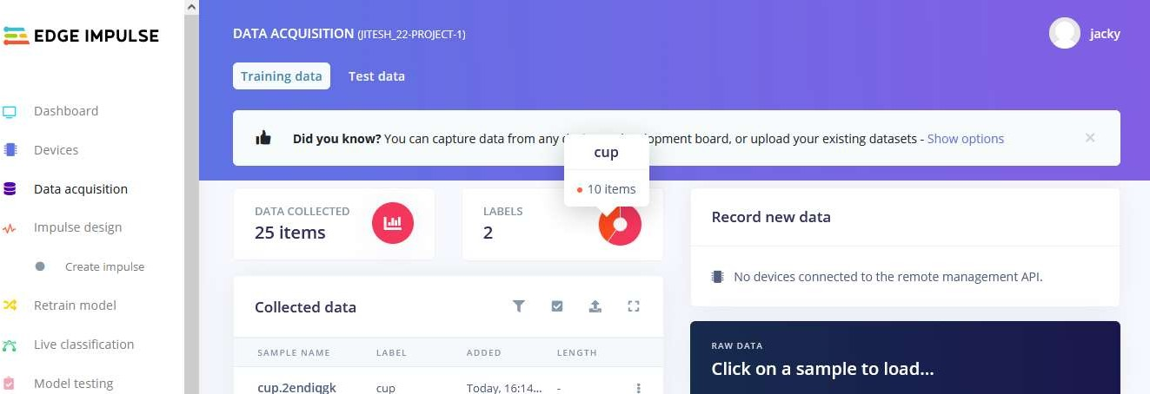
WE NEED DATA WITH 2 LABELS

Slide 17
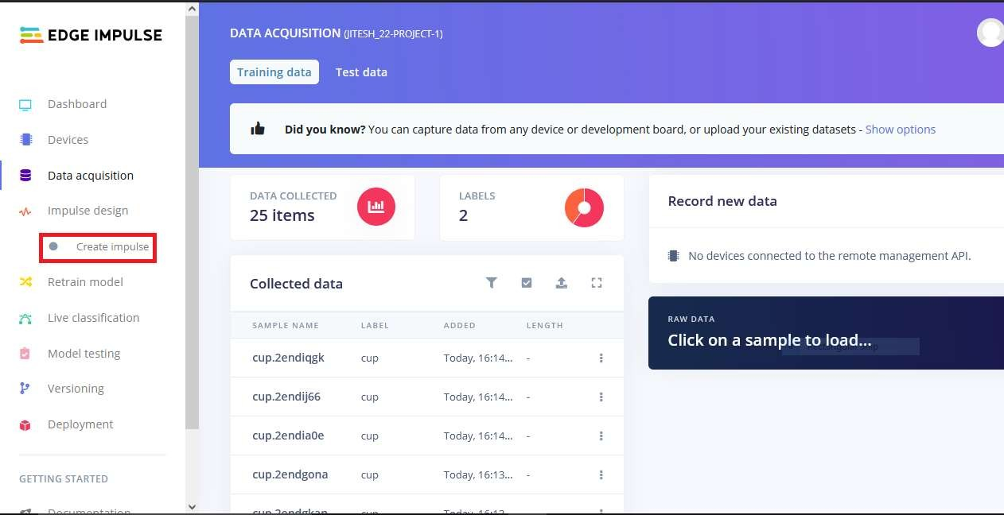
CLICK ON CREATE IMPULSE

Slide 18
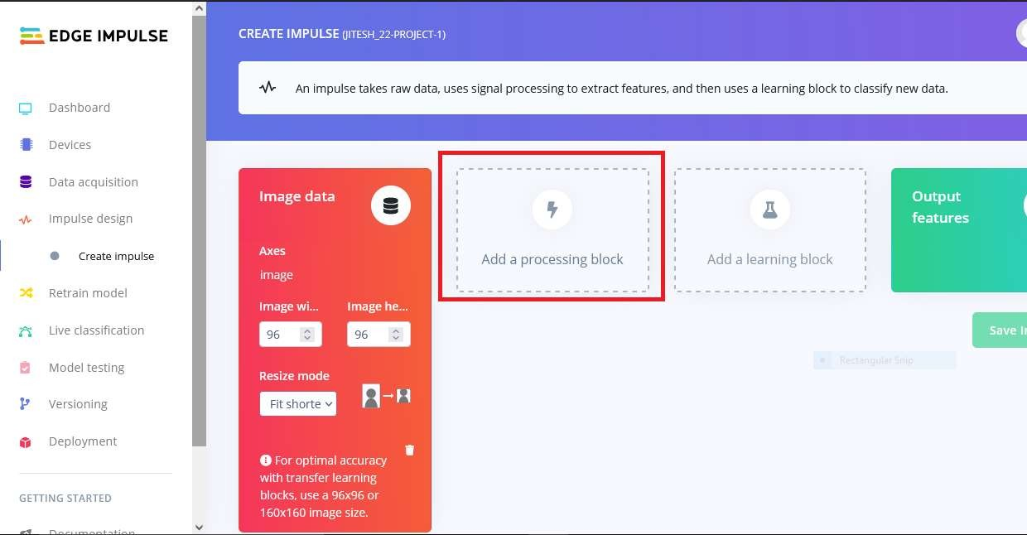
NOW ADD DATA PROCESSING BLOCK

Slide 19
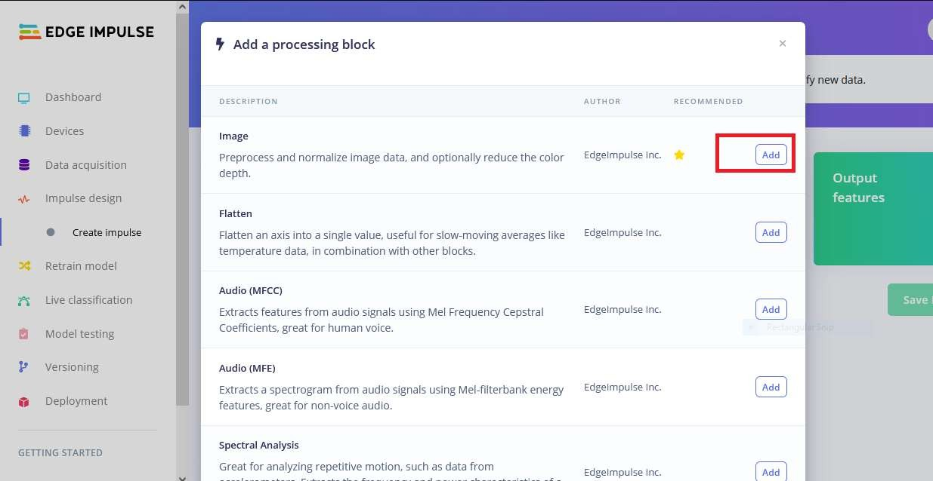
SELECT PROCESSING BLOCK

Slide 20
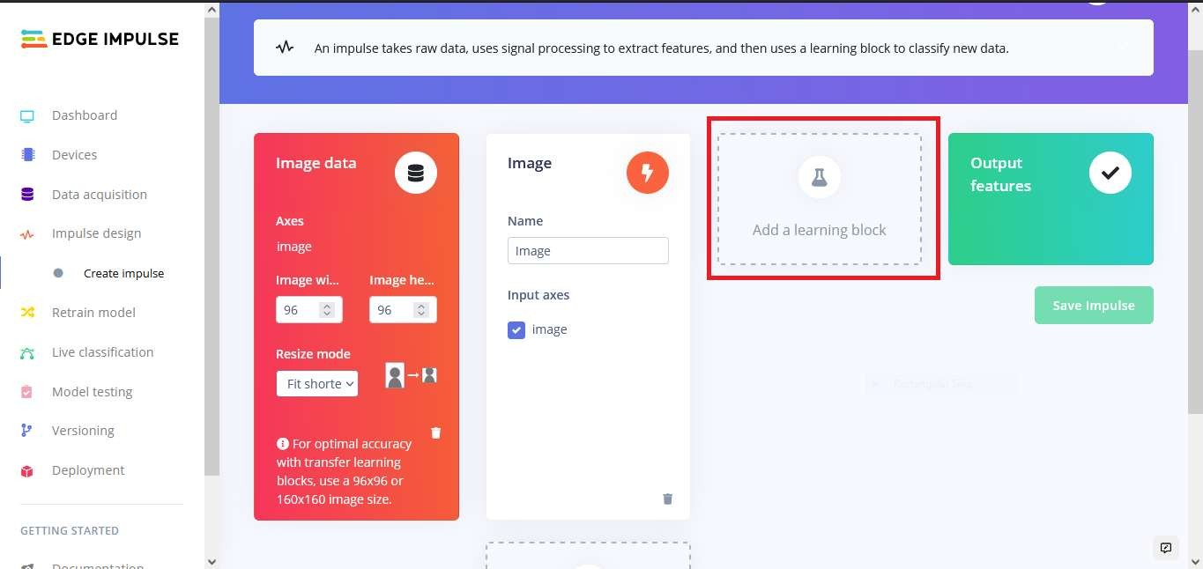
ADD LEARNING BLOCK

Slide 21
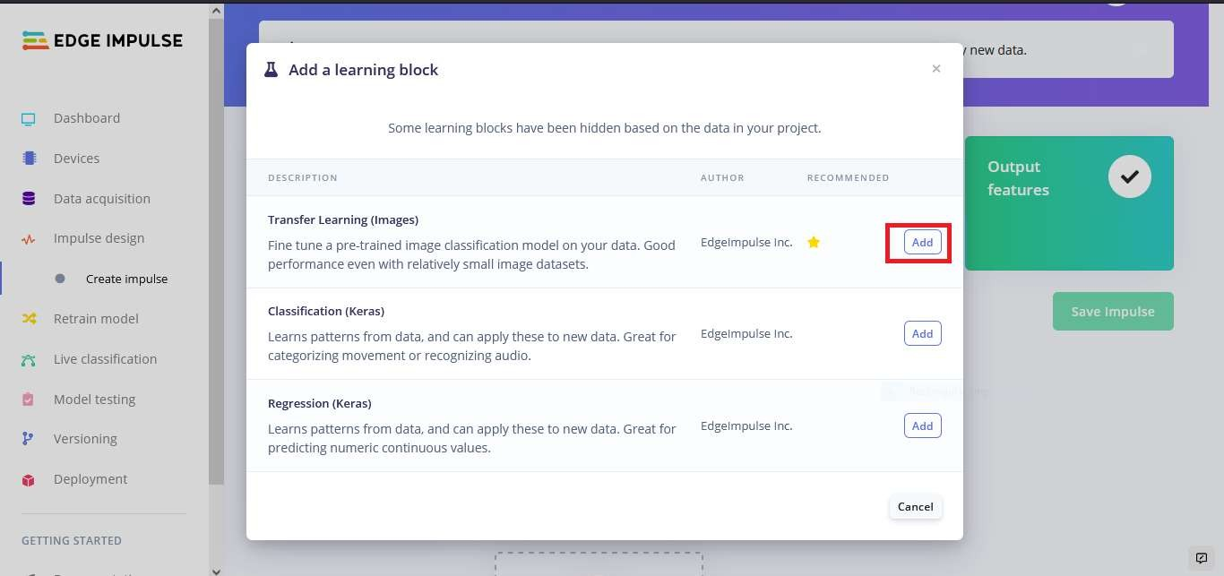
SELECT LEARNING BLOCK

Slide 22
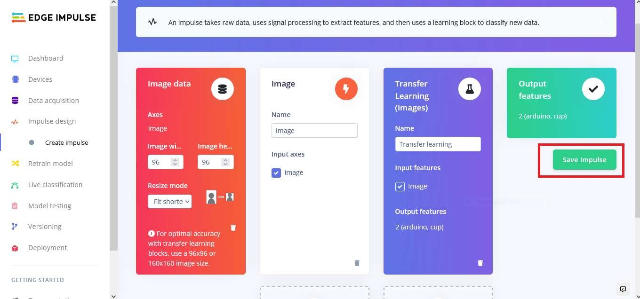
SAVE IMPULSE

Slide 23
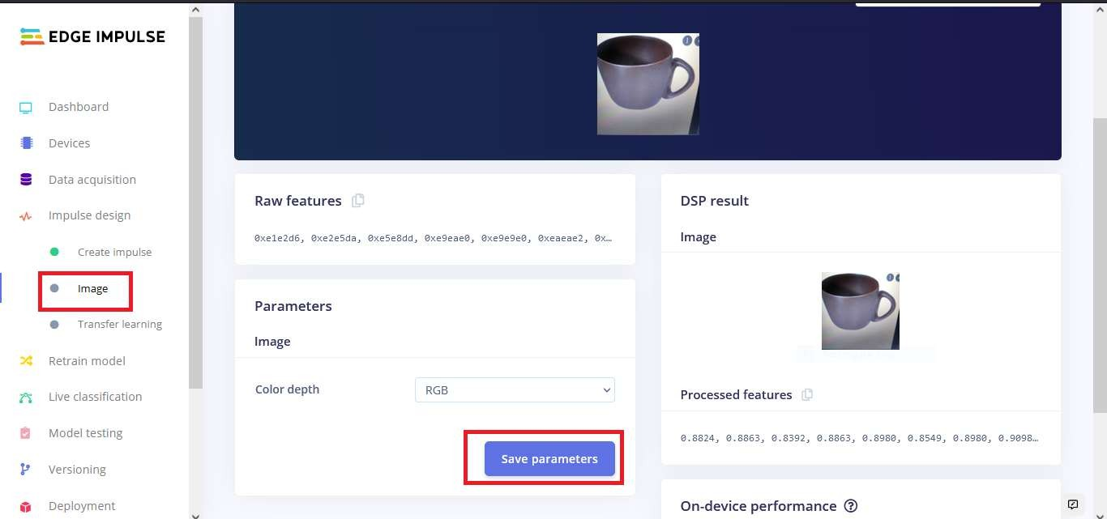
Click On Processing block And Then Click On Save Parameters

Slide 24
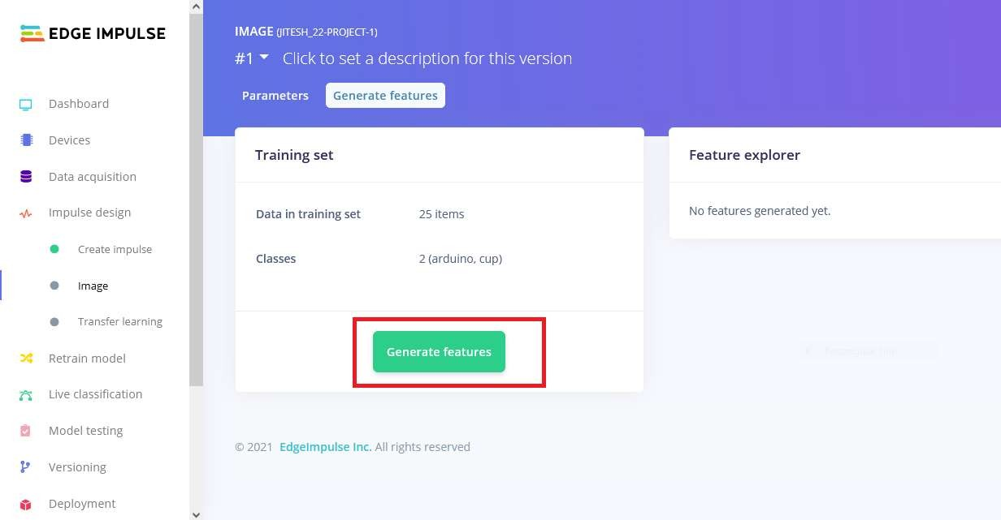
NOW CLICK ON GENERATE FEATURES

Slide 25
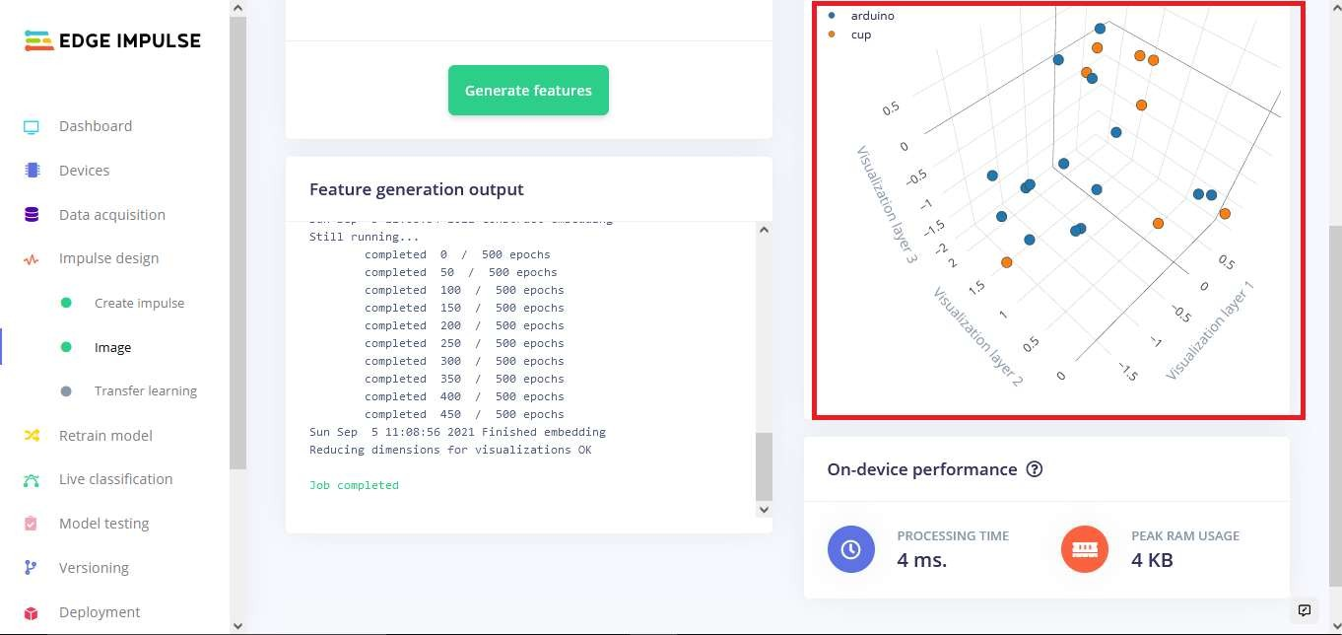
Graph of Features

Slide 26
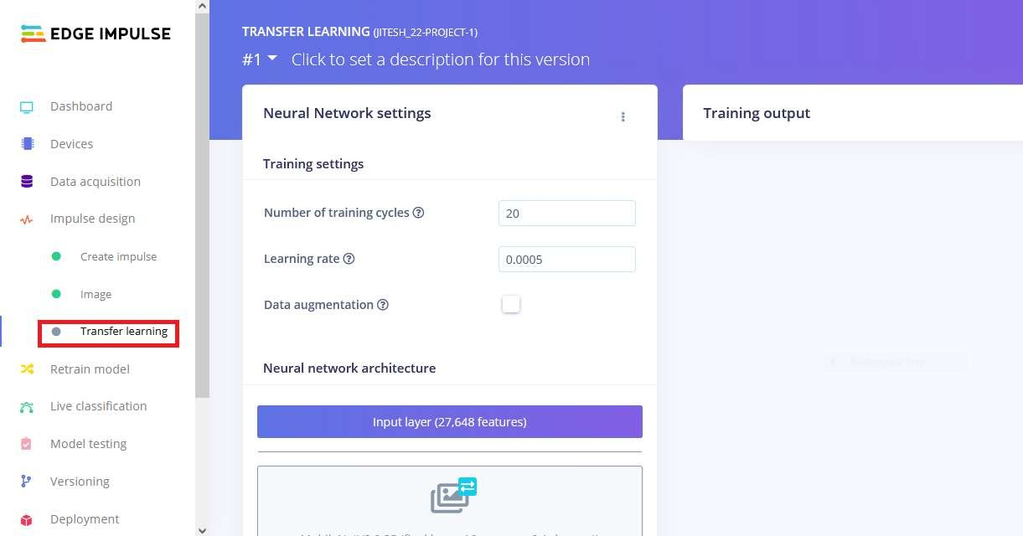
CLICK ON TRANSFER LERANING

Slide 27
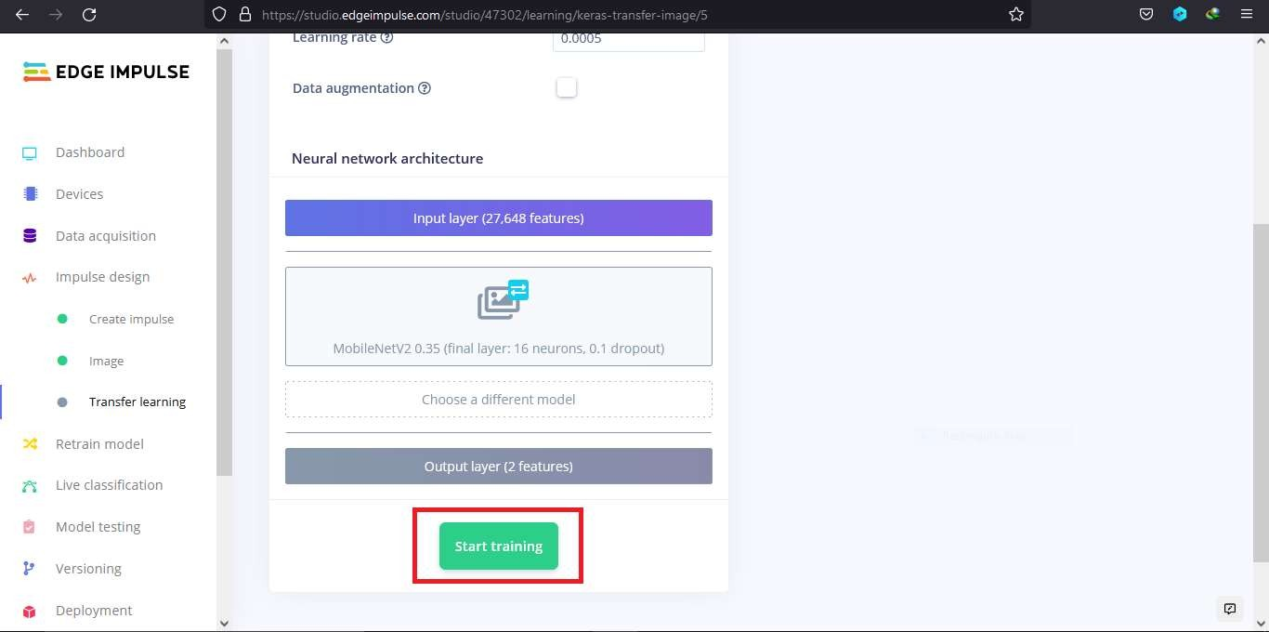
CLICK ON START TRAINING

Slide 28
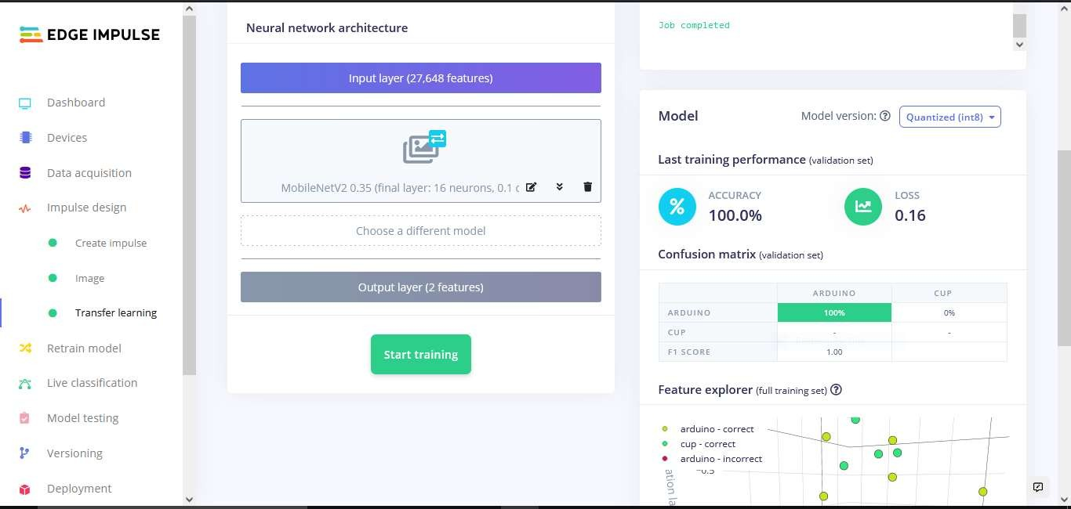

Slide 29
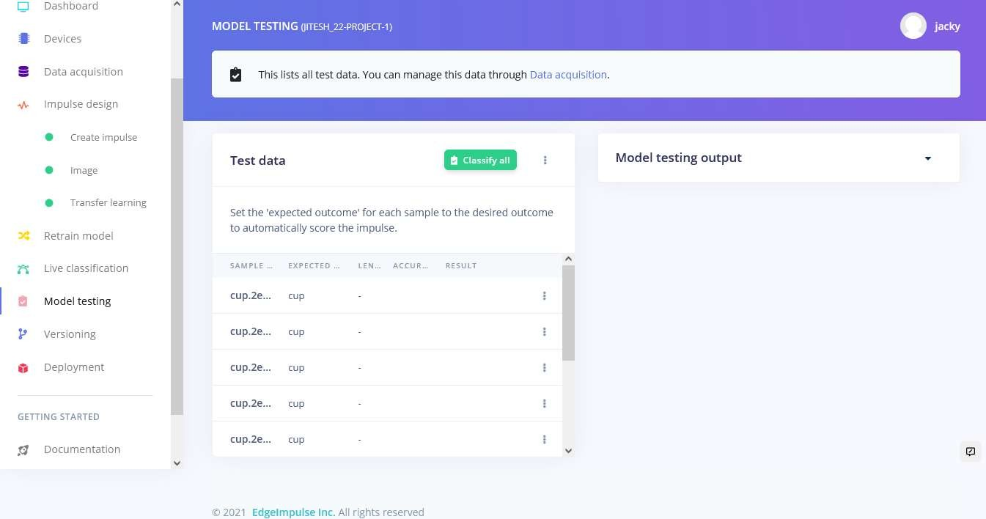
TESTING MODEL

Slide 30
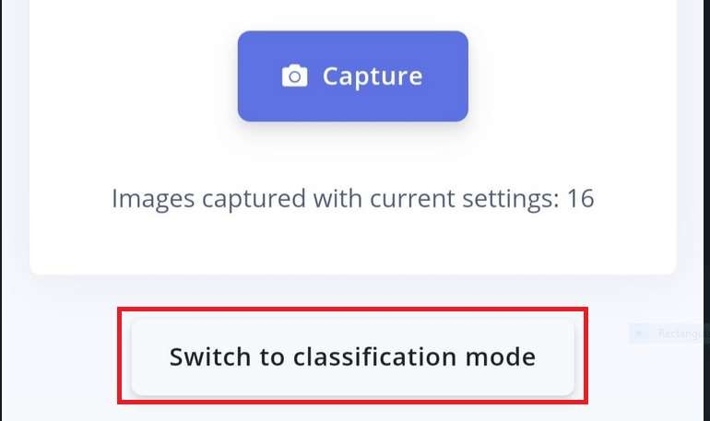
CLICK ON SWITCH TO CLASSFICATION MODE ON MOBILE

Slide 31
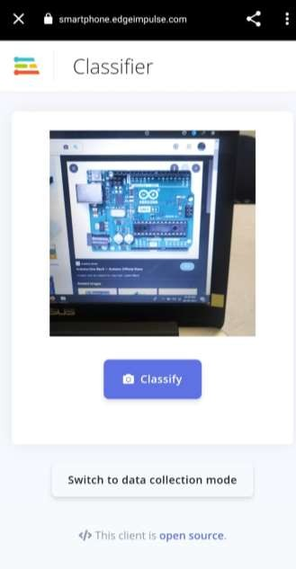
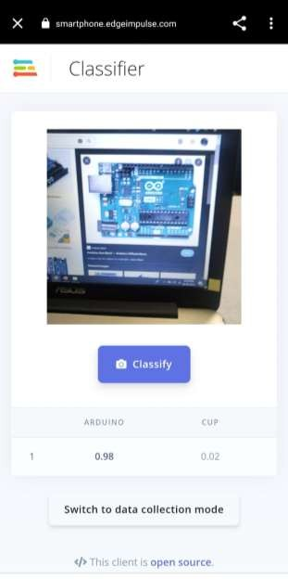
Classification Results

Slide 32







THANK YOU!
THANK YOU!
For Further Information:
https://tih.iitr.ac.in/
www.uniconvergetech.in
www.theiotacademy.co
You can also visit us at:

